Slide 1
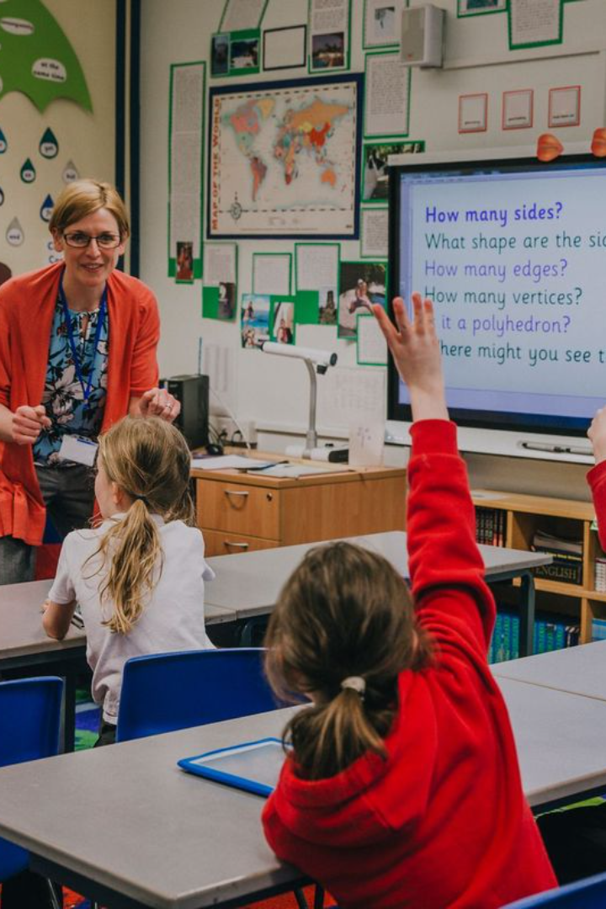
Qualities of a Good Teacher
Being a good teacher goes beyond subject expertise and includes various essential characteristics.
Dhiraj Kumar Shah
s
Symbol no:7621009

Slide 2
Knowledge and Expertise in the Subject Matter
Deep Understanding
Up-to-Date Knowledge
Passionate about Learning
Requires a thorough grasp of the subject matter being taught.
Staying informed about the latest advancements and discoveries.
Sparking curiosity and enthusiasm for the subject in students.

Slide 3

Effective Communication Skills
1
Clarity and Transparency
2
Active Listening
Conveying information in a clear, understandable manner.
Understands student concerns and responds compassionately.
3
Non-Verbal Cues
Utilizing body language to enhance communication.

Slide 4
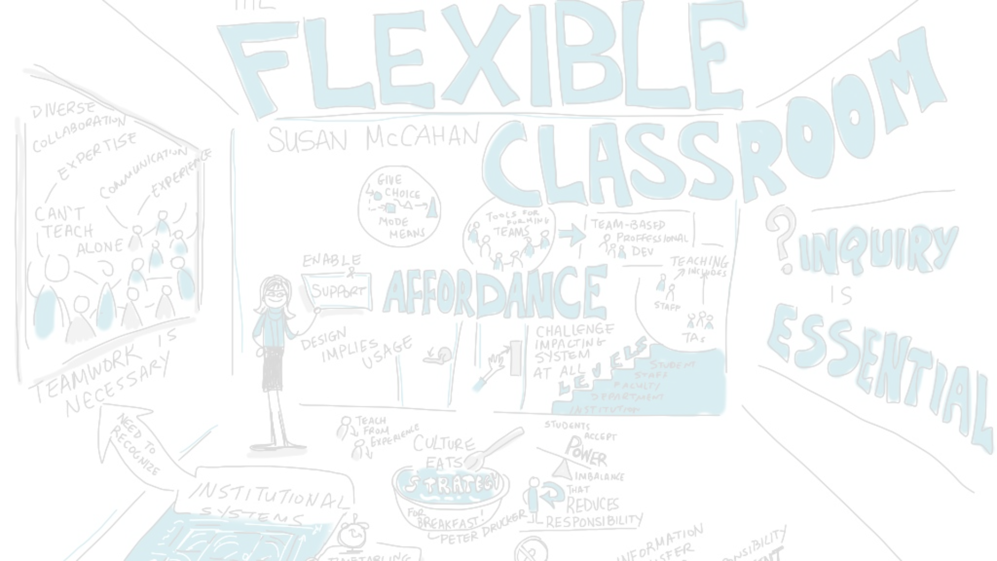
Adaptability and Flexibility in Teaching Methods
Customized Approaches
Resourcefulness
Innovative Strategies
Being adaptable and making the best use of available resources.
Embracing new and creative teaching methods.
Adjusting teaching techniques to suit individual student needs.

Slide 5
Creating an Interactive Classroom Environment
1
2
3
Engaging Activities
Technology Integration
Collaborative Learning

Slide 6



Encouraging Student Participation and Engagement
Inclusivity
Active Involvement
Collaborative Learning
Ensuring every student feels included and valued.
Encouraging students to participate and share their opinions.
Promoting group work and cooperative learning activities.

Slide 7
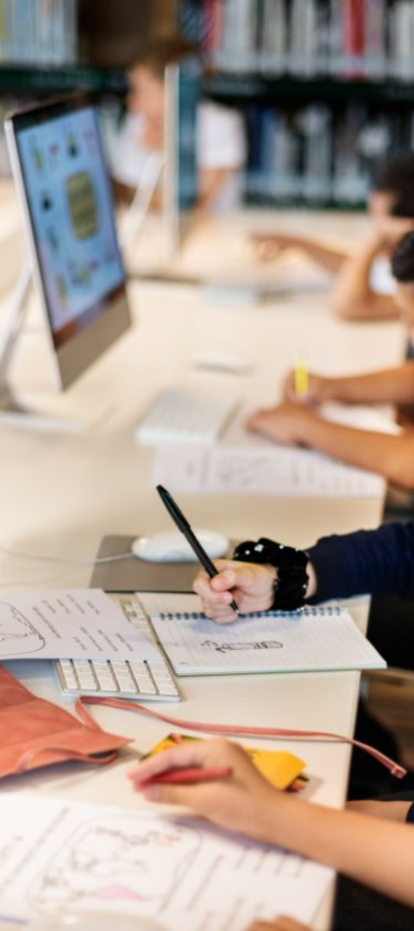



Utilizing Technology and Multimedia Tools in Teaching
Interactive Presentations
Creating visually engaging slideshows and interactive materials.
Online Resources
Integrating online platforms and educational websites.
Virtual Labs
Utilizing digital simulations for practical demonstrations.

Slide 8

Thank You and Any Questions?
1
Open Communication
Feel free to ask any questions or share your thoughts.

